Slide 1


Business Analytics DataBurger & Craft Gruppe#1 Dorian, Nikolay, Sascha, Micha

Slide 2
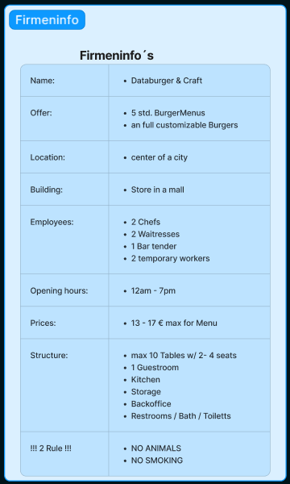

Business Analytics DataBurger & Craft Gruppe#1 Dorian, Nikolay, Sascha, Micha

Slide 3
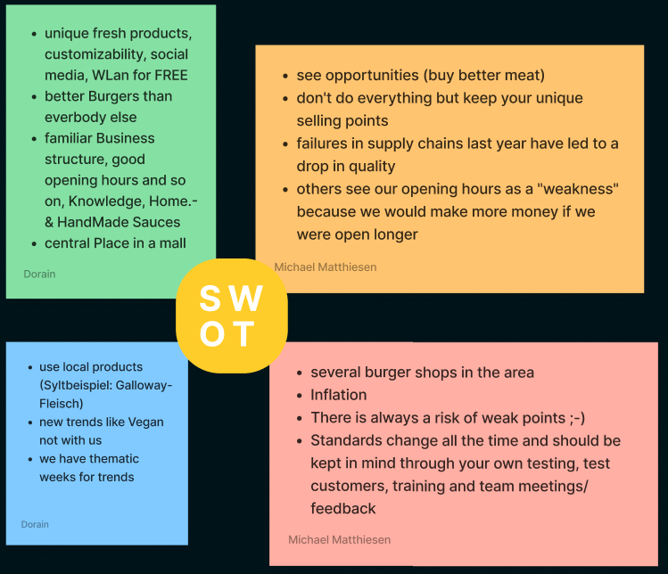


Business Analytics DataBurger & Craft Gruppe#1 Dorian, Nikolay, Sascha, Micha

Slide 4
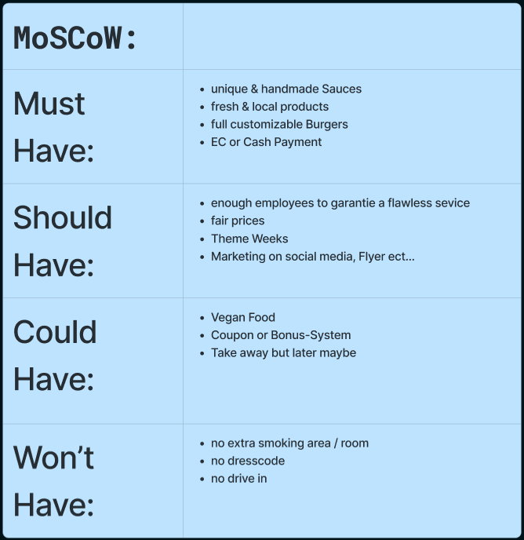
Business Analytics DataBurger & Craft Gruppe#1 Dorian, Nikolay, Sascha, Micha

Slide 5
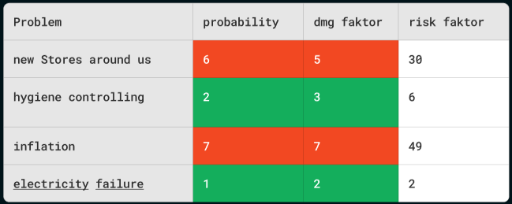
Business Analytics DataBurger & Craft Gruppe#1 Dorian, Nikolay, Sascha, Micha

Slide 6

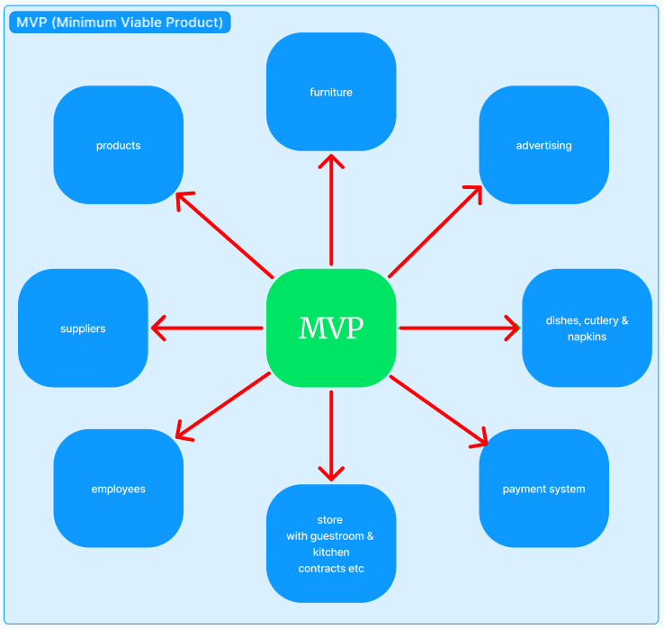
Business Analytics DataBurger & Craft Gruppe#1 Dorian, Nikolay, Sascha, Micha

Slide 7
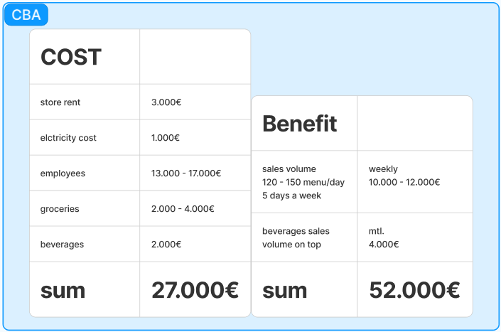
Business Analytics DataBurger & Craft Gruppe#1 Dorian, Nikolay, Sascha, Micha

Slide 8

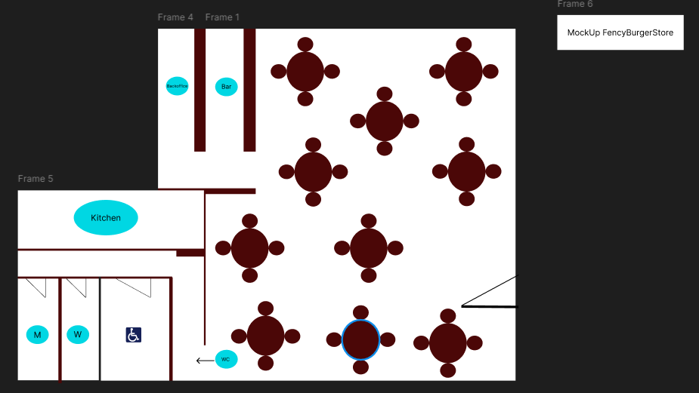
Business Analytics DataBurger & Craft Gruppe#1 Dorian, Nikolay, Sascha, Micha

Slide 9
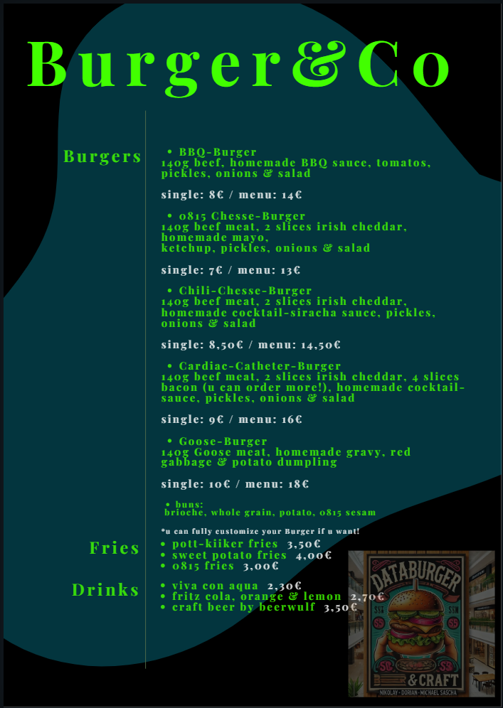
Business Analytics DataBurger & Craft Gruppe#1 Dorian, Nikolay, Sascha, Micha

